Slide 1
Unit=4
Introduction to fuzzy logic (CO3)

Slide 2
Content
Classical( Crisp Set) and Fuzzy Set
Operational and Properties
Fuzzy Relations, Cardinality, Operational and Properties
Equivalence and Tolerance Relations
Value Assignment
Fuzzification
Defuzzification
Fuzzy Measures, Fuzzy Integrals
Consideration of Fuzzy Decision Making

Slide 3
ORIGINS OF FUZZY LOGIC
Traces back to Ancient Greece
Lotfi Asker Zadeh ( 1965 )
  First to publish ideas of fuzzy logic.
Professor Toshire Terano ( 1972 )
  Organized the world's first working group on fuzzy systems.
F.L. Smidth & Co. ( 1980 )
  First to market fuzzy expert systems.
Notes:
3

Slide 4
WHAT IS FUZZY LOGIC?
Definition of fuzzy
  Fuzzy – “not clear, distinct, or precise; blurred”
Definition of fuzzy logic
  A form of knowledge representation suitable for notions that cannot be defined precisely, but which depend upon their contexts.
Notes:
4

Slide 5
What is Fuzzy Control?
It is a technique to embody human-like thinking into a control system.
It may not be designed to give accurate reasoning but it is designed to give acceptable reasoning.
It can emulate human deductive thinking, that is, the process people use to infer conclusions from what they know.
Any uncertainties can be easily dealt with the help of fuzzy logic.

Slide 6
Advantages of Fuzzy Logic System
This system can work with any type of inputs whether it is imprecise, distorted or noisy input information.
The construction of Fuzzy Logic Systems is easy and understandable.
Fuzzy logic comes with mathematical concepts of set theory and the reasoning of that is quite simple.
It provides a very efficient solution to complex problems in all fields of life as it resembles human reasoning and decision-making.
The algorithms can be described with little data, so little memory is required.

Slide 7
Disadvantages of Fuzzy Logic Systems
Many researchers proposed different ways to solve a given problem through fuzzy logic which leads to ambiguity. There is no systematic approach to solve a given problem through fuzzy logic.
Proof of its characteristics is difficult or impossible in most cases because every time we do not get a mathematical description of our approach.
As fuzzy logic works on precise as well as imprecise data so most of the time accuracy is compromised.

Slide 8
Application
It is used in the aerospace field for altitude control of spacecraft and satellites.
It has been used in the automotive system for speed control, traffic control.
It is used for decision-making support systems and personal evaluation in the large company business.
It has application in the chemical industry for controlling the pH, drying, chemical distillation process.
Fuzzy logic is used in Natural language processing and various intensive applications in Artificial Intelligence.
Fuzzy logic is extensively used in modern control systems such as expert systems.
Fuzzy Logic is used with Neural Networks as it mimics how a person would make decisions, only much faster. It is done by Aggregation of data and changing it into more meaningful data by forming partial truths as Fuzzy sets.

Slide 9
FUZZY LOGIC IN CONTROL SYSTEMS
Fuzzy Logic provides a more efficient and resourceful way to solve Control Systems.
Some Examples
  Temperature Controller
  Anti – Lock Break System ( ABS )
  IFB and Bosch (Washing Machine)
Notes:
9

Slide 10
Introduction
Uncertainty
  Probability theory is capable of representing only one of several distinct types of uncertainty.
  When A is a fuzzy set and x is a relevant object, the proposition “x is a member of A” is not necessarily either true or false. It may be true only to some degree, the degree to which x is actually a member of A.
  For example: the weather today
    Sunny: If we define any cloud cover of 25% or less is sunny.
    This means that a cloud cover of 26% is not sunny?

Slide 11


TRADITIONAL REPRESENTATION OF LOGIC
Slow
Fast
Speed = 0
Speed = 1
Notes:
11

Slide 12


FUZZY LOGIC REPRESENTATION
Slowest
For every problem must represent in terms of fuzzy sets.
What are fuzzy sets?
[ 0.0 – 0.25 ]
Slow
[ 0.25 – 0.50 ]
Fast
[ 0.50 – 0.75 ]
Fastest
[ 0.75 – 1.00 ]
Notes:
12

Slide 13


FUZZY LOGIC REPRESENTATION CONT.
Slowest
Slow
Fast
Fastest
Notes:
13

Slide 14
Crisp Set and Fuzzy Set

Slide 15
Information World
Crisp set has a unique membership function
μ_{A}(x) = 1 x ∈ A
0 x ∉ A
μ_{A}(x) ∈ {0, 1}
Fuzzy Set can have an infinite number of membership functions
μ_{A} ∈ [0,1]

Slide 16
Fuzzy Introduction
Fuzzy set theory provides a means for representing uncertainties.
Fuzzy set theory uses Linguistic variables, rather than quantitative variables to represent imprecise concepts.

Slide 17
Fuzzy Logic
Fuzzy Logic is suitable to Very complex models
Reasoning
Perception
Decision making

Slide 18
Crisp Set Vs Fuzzy Set
The crisp set v.s. the fuzzy set
  The crisp set is defined in such a way as to dichotomize the individuals in some given universe of discourse into two groups: members and nonmembers.
    However, many classification concepts do not exhibit this characteristic.
    For example, the set of tall people, expensive cars, or sunny days.
  A fuzzy set can be defined mathematically by assigning to each possible individual in the universe of discourse a value representing its grade of membership in the fuzzy set.
    For example: a fuzzy set representing our concept of sunny might assign a degree of membership of 1 to a cloud cover of 0%, 0.8 to a cloud cover of 20%, 0.4 to a cloud cover of 30%, and 0 to a cloud cover of 75%.

Slide 19
Crisp Set and Fuzzy Set

Slide 20
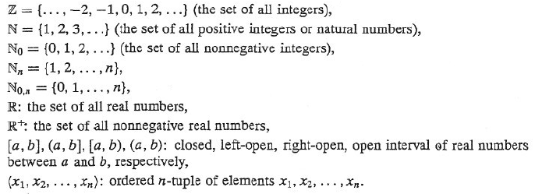
Crisp sets: an overview
The theory of crisp set
  The following general symbols are employed throughout the text:

Slide 21
Crisp sets: an overview
Three basic methods to define sets:
  The list method: a set is defined by naming all its members.
  The rule method: a set is defined by a property satisfied by its members.
  where ‘|’ denotes the phrase “such that”
  P(x): a proposition of the form “x has the property P ”
  A set is defined by a characteristic function.
  the characteristic function

Slide 22
Crisp sets: an overview
A family of sets: a set whose elements are sets
  It can be defined in the form:
  where i and I are called the set index and the index set, respectively.
  The family of sets is also called an indexed set.
  For example: A
A is a subset of B:
A, B are equal sets:
A and B are not equal:
A is proper subset of B:
A is included in B:

Slide 23
Crisp sets: an overview
The power set of A : the family of all subsets of a given set A.
  The second order power set of A:
  The higher order power set of A:
The cardinality of A (|A|): the number of members of a finite set A.
  For example:
B – A: the relative complement of a set A with respect to set B
  If the set B is the universal set, then

Slide 24
Crisp sets: an overview
The union of sets A and B:
The generalized union operation: for a family of sets,
The intersection of sets A and B:
The generalized intersection operation: for a family of sets,

Slide 25
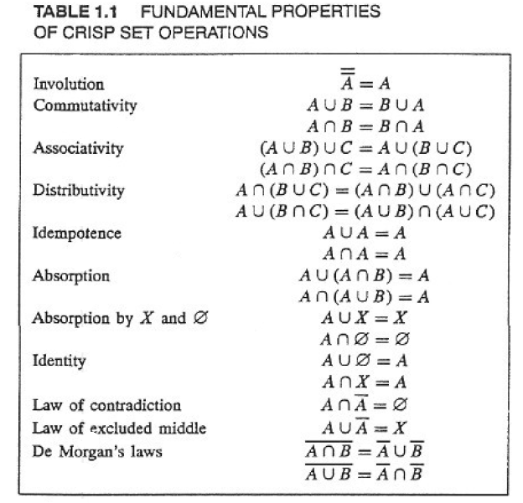
Crisp sets: an overview

Slide 26
CLASSICAL SETS
Define a universe of discourse, X, as a collection of objects all having the same characteristics. The individual elements in the universe X will be denoted as x. The features of the elements in X can be discrete, or continuous valued quantities on the real line. Examples of elements of various universes might be as follows:
the clock speeds of computer CPUs;
the operating currents of an electronic motor;
the operating temperature of a heat pump;
the integers 1 to 10.

Slide 27
Operations on Classical Sets
Union:
A ∪ B = {x | x ∈ A or x ∈ B}
Intersection:
A ∩ B = {x | x ∈ A and x ∈ B}
Complement:
A’ = {x | x ∉ A, x ∈ X}
X – Universal Set
Set Difference:
A | B = {x | x ∈ A and x ∉ B}
Set difference is also denoted by A - B

Slide 28
Operations on Classical Sets
Union of sets A and B (logical or).
Intersection of sets A and B.

Slide 29
Operations on Classical Sets
Complement of set A.
Difference operation A|B.

Slide 30
Properties of Classical Sets
A ∪ B = B ∪ A
A ∩ B = B ∩ A
A ∪ (B ∪ C) = (A ∪ B) ∪ C
A ∩ (B ∩ C) = (A ∩ B) ∩ C
A ∪ (B ∩ C) = (A ∪ B) ∩ (A ∪ C)
A ∩ (B ∪ C) = (A ∩ B) ∪ (A ∩ C)
A ∪ A = A
A ∩ A = A
A ∪ X = X
A ∩ X = A
A ∪ ∅ = A
A ∩ ∅ = ∅

Slide 31
Mapping of Classical Sets to Functions
Mapping is an important concept in relating set-theoretic forms to function-theoretic representations of information. In its most general form it can be used to map elements or subsets in one universe of discourse to elements or sets in another universe.

Slide 32
Fuzzy Sets

Slide 33
Fuzzy Sets
A fuzzy set, is a set containing elements that have varying degrees of membership in the set.
Elements in a fuzzy set, because their membership need not be complete, can also be members of other fuzzy sets on the same universe.
Elements of a fuzzy set are mapped to a universe of membership values using a function-theoretic form.

Slide 34
Fuzzy Set Theory
An object has a numeric “degree of membership”
Normally, between 0 and 1 (inclusive)
  0 membership means the object is not in the set
  1 membership means the object is fully inside the set
  In between means the object is partially in the set

Slide 35

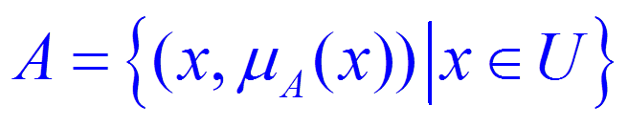
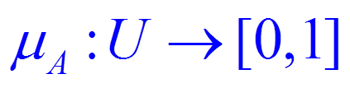
If U is a collection of objects denoted generically by x, then a fuzzy set A in U is defined as a set of ordered pairs:
membership
function
U : universe of
discourse.

Slide 36
Fuzzy Sets
Characteristic function X, indicating the belongingness of x to the set A
X(x) = 1 x ∈ A
0 x ∉ A
or called membership
Hence,
A ∪ B → X_{A ∪ B}(x)
= X_{A}(x) ∪ X_{B}(x)
= max(X_{A}(x),X_{B}(x))

Slide 37
Fuzzy Sets
A ∩ B → X_{A ∩ B}(x)
= X_{A}(x) ∩ X_{B}(x)
= min(X_{A}(x),X_{B}(x))
A’ → X_{A’}(x)
= 1 – X_{A}(x)
A’’ = A

Slide 38
Fuzzy Set Operations
μ_{A ∪ B}(x) = μ_{A}(x) ∪ μ_{B}(x)
= max(μ_{A}(x), μ_{B}(x))
μ_{A ∩ B}(x) = μ_{A}(x) ∩ μ_{B}(x)
= min(μ_{A}(x), μ_{B}(x))
μ_{A’}(x) = 1 - μ_{A}(x)
De Morgan’s Law also holds:
(A ∩ B)’ = A’ ∪ B’
(A ∪ B)’ = A’ ∩ B’
But, in general
A ∪ A’
A ∩ A’

Slide 39
Fuzzy Set Operations
Union of fuzzy sets A and B∼
.
Intersection of fuzzy sets A and B∼
.

Slide 40
Fuzzy Set Operations
Complement of fuzzy set A∼
.

Slide 41
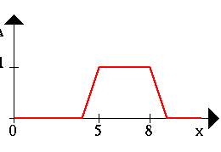
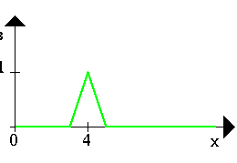
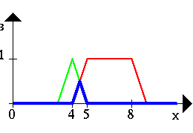
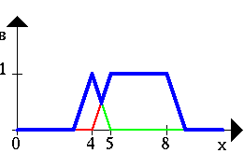
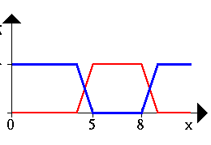
Operations
A B
A ∧ B A ∨ B ¬A

Slide 42

A ∪ A’ = X A ∩ A’ = Ø
Excluded middle axioms for crisp sets. (a) Crisp set A and its complement; (b) crisp A ∪ A = X (axiom of excluded middle); and (c) crisp A ∩ A = Ø (axiom of contradiction).

Slide 43



A ∪ A’ A ∩ A’
Excluded middle axioms for fuzzy sets are not valid. (a) Fuzzy set A∼ and its complement; (b) fuzzy A ∪ A∼ = X (axiom of excluded middle); and (c) fuzzy A ∩ A = Ø (axiom of contradiction).

Slide 44
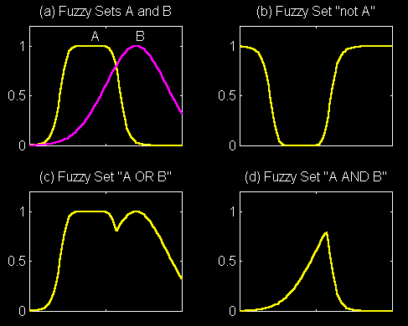
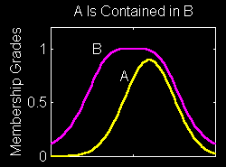
Set-Theoretic Operations

Slide 45
Examples of Fuzzy Set Operations
Fuzzy union (∪): the union of two fuzzy sets is the maximum (MAX) of each element from two sets.
E.g.
  A = {1.0, 0.20, 0.75}
  B = {0.2, 0.45, 0.50}
  A ∪ B = {MAX(1.0, 0.2), MAX(0.20, 0.45), MAX(0.75, 0.50)} = {1.0, 0.45, 0.75}

Slide 46
Examples of Fuzzy Set Operations
Fuzzy intersection (∩): the intersection of two fuzzy sets is just the MIN of each element from the two sets.
E.g.
  A ∩ B = {MIN(1.0, 0.2), MIN(0.20, 0.45), MIN(0.75, 0.50)} = {0.2, 0.20, 0.50}

Slide 47
Examples of Fuzzy Set Operations
The complement of a fuzzy variable with DOM x is (1-x).
Example.
  A^{c} = {1 – 1.0, 1 – 0.2, 1 – 0.75} = {0.0, 0.8, 0.25}

Slide 48
Properties of Fuzzy Sets
A ∪ B = B ∪ A
A ∩ B = B ∩ A
A ∪ (B ∪ C) = (A ∪ B) ∪ C
A ∩ (B ∩ C) = (A ∩ B) ∩ C
A ∪ (B ∩ C) = (A ∪ B) ∩ (A ∪ C)
A ∩ (B ∪ C) = (A ∩ B) ∪ (A ∩ C)
A ∪ A = A A ∩ A = A
A ∪ X = X A ∩ X = A
A ∪ ∅ = A A ∩ ∅ = ∅
If A ⊆ B ⊆ C, then A ⊆ C
A’’ = A

Slide 49
Fuzzy Sets
Note μ(x) ∈ [0,1]
not {0,1} like Crisp set
A = {μ_{A}(x1) / x1 + μ_{A}(x2) / x2 + …}
= {∑ μ_{A}(xi) / xi}
Note: ‘+’ ≠ add
‘/ ’ ≠ divide
Only for representing element and its membership.
Also some books use μ(x) for Crisp Sets too.

Slide 50
Example (Discrete Universe)
# courses a student may take in a semester.
appropriate
# courses taken
1
0.5
0
2
4
6
8
x : # courses

Slide 51
Example (Discrete Universe)
# courses a student may take in a semester.
appropriate
# courses taken
Alternative Representation:

Slide 52
Example (Continuous Universe)
U : the set of positive real numbers
possible ages
about 50 years old
Alternative Representation:
x : age

Slide 53
Alternative Notation
U : discrete universe
U : continuous universe
Note that ∑ and integral signs stand for the union of membership grades; “ / ” stands for a marker and does not imply division.

Slide 54
Fuzzy Disjunction
A∨B max(A, B)
A∨B = C "Quality C is the disjunction of Quality A and B"
(A∨B = C) ⇒ (C = 0.75)

Slide 55
Fuzzy Conjunction
A∧B min(A, B)
A∧B = C "Quality C is the conjunction of Quality A and B"
(A∧B = C) ⇒ (C = 0.375)

Slide 56
Example: Fuzzy Conjunction
Calculate A∧B given that A is .4 and B is 20

Slide 57
Example: Fuzzy Conjunction
Calculate A∧B given that A is .4 and B is 20
  Determine degrees of membership:

Slide 58
Example: Fuzzy Conjunction
Calculate A∧B given that A is .4 and B is 20
0.7
  Determine degrees of membership:
    A = 0.7

Slide 59
Example: Fuzzy Conjunction
Calculate A∧B given that A is .4 and B is 20
0.9
0.7
  Determine degrees of membership:
    A = 0.7 B = 0.9

Slide 60
Example: Fuzzy Conjunction
Calculate A∧B given that A is .4 and B is 20
0.9
0.7
  Determine degrees of membership:
    A = 0.7 B = 0.9
  Apply Fuzzy AND
    A∧B = min(A, B) = 0.7

Slide 61
Generalized Union/Intersection
Generalized Union
Or called triangular norm.
Generalized Intersection
t-norm
t-conorm
Or called s-norm.

Slide 62
T-norms and S-norms
And/OR definitions are called T-norms (S-norms)
  Duals of one another
  A definition of one defines the other implicitly
Many different ones have been proposed
  Min/Max, Product/Bounded-Sum, etc.

Slide 63
Examples: T-Norm & T-Conorm
Minimum/Maximum:
Lukasiewicz:

Slide 64
Fuzzy Relations

Slide 65
Crisp Relation (R)
b₁
a₁
A
b₂
a₂
B
b₃
a₃
b₄
a₄
b₅

Slide 66
Crisp Relation (R)
b₁
a₁
A
b₂
a₂
B
b₃
a₃
b₄
a₄
b₅

Slide 67
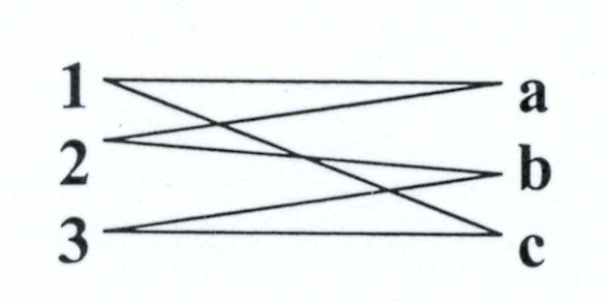
Crisp Relations
Example:
If X = {1,2,3}
Y = {a,b,c}
R = { (1 a),(1 c),(2 a),(2 b),(3 b),(3 c) }
a b c
1 1 0 1
R = 2 1 1 0
3 0 1 1
Using a diagram to represent the relation

Slide 68
The Real-Life Relation
x is close to y
  x and y are numbers
x depends on y
  x and y are events
x and y look alike
  x and y are persons or objects
If x is large, then y is small
  x is an observed reading and y is a corresponding action

Slide 69
Fuzzy Relations
Triples showing connection between two sets:
(a,b,#): a is related to b with degree #
Fuzzy relations are set themselves
Fuzzy relations can be expressed as matrices

Slide 70
Fuzzy Relations Matrices
Example: Color-Ripeness relation for tomatoes
R₁(x, y) | unripe | semi ripe | ripe
green | 1 | 0.5 | 0
yellow | 0.3 | 1 | 0.4
Red | 0 | 0.2 | 1

Slide 71
Composition
Let R be a relation that relates, or maps, elements from universe X to universe Y, and let S be a relation that relates, or maps, elements from universe Y to universe Z.
A useful question we seek to answer is whether we can find a relation, T, that relates the same elements in universe X that R contains to the same elements in universe Z that S contains. It turns out that we can find such a relation using an operation known as composition.

Slide 72
Composition
There are two common forms of the composition operation:
max–min composition
max–product composition.

Slide 73
Max-Min Composition
X
Y
Z
R: fuzzy relation defined on X and Y.
S: fuzzy relation defined on Y and Z.
R 。S: the composition of R and S.
A fuzzy relation defined on X an Z.

Slide 74
Example
min
max

Slide 75
Max-Product Composition
.
X
Y
Z
R: fuzzy relation defined on X and Y.
S: fuzzy relation defined on Y and Z.
R。S: the composition of R and S.
A fuzzy relation defined on X an Z.

Slide 76


Example
Product
max
.09 .04 0.0 0.4
R ° S | α | β | γ
1 | 0.4 | 0.2 | 0.3
2 | 0.27 | 0.3 | 0.24
3 | 0.8 | 0.9 | 0.7

Slide 77
Example
Suppose we are interested in understanding the speed control of the DC shunt motor under no-load condition, as shown.

Slide 78
Example
Initially, the series resistance Rse in should be kept in the cut-in position for the following reasons:
1. The back electromagnetic force, given by Eb = kNφ, where k is a constant of proportionality, N is the motor speed, and φ is the flux (which is proportional to input voltage, V ), is equal to zero because the motor speed is equal to zero initially.
2. We have V = Eb + Ia(Ra + Rse), therefore Ia = (V − Eb)/(Ra + Rse), where Ia is the armature current and Ra is the armature resistance. Since Eb is equal to zero initially, the armature current will be Ia = V/(Ra + Rse), which is going to be quite large initially and may destroy the armature.

Slide 79
Example
Let Rse be a fuzzy set representing a number of possible values for series resistance, say sn values, given as
and let Ia be a fuzzy set having a number of possible values of the armature current, say m values, given as
The fuzzy sets Rse and Ia can be related through a fuzzy relation, say R, which would allow for the establishment of various degrees of relationship between pairs of resistance and current.

Slide 80
Example
Let N be another fuzzy set having numerous values for the motor speed, say v values, given as
Now, we can determine another fuzzy relation, say S, to relate current to motor speed, that is, Ia to N.
Using the operation of composition, we could then compute a relation, say T, to be used to relate series resistance to motor speed, that is, Rse to N.

Slide 81
Example
The operations needed to develop these relations are as follows – two fuzzy Cartesian products and one composition:

Slide 82
Example
Suppose the membership functions for both series resistance Rse and armature current Ia are given in terms of percentages of their respective rated values, that is,

Slide 83
Example
The following relation then result from use of the Cartesian product to determine R:

Slide 84
Example 3.8
Cartesian product to determine S:

Slide 85
Example
The following relation results from a max–min composition for T:

Slide 86
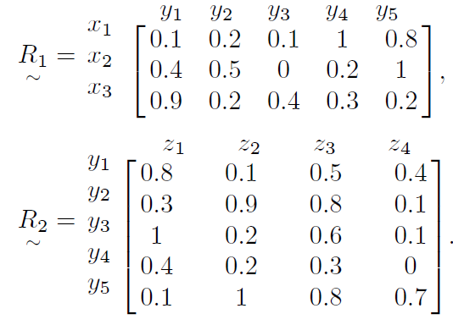
HW

